Slide 1
Morphology fundamentals

Slide 2
What is Morphology?
Study of Words
Their internal structure
How they are formed?
Morphology tries to formulate rules
washing
wash
-ing
bat
bats
rat
rats
write
writer
browse
browser

Slide 3
Morphology
Morphology is the study of the structure of words.
Morphology breaks words down into their stems or root words, prefixes and suffixes.
A stem is the core part of the word, while prefixes are added to the beginning of the stem and suffixes are added at the end of the stems.

Slide 4
Morphology for NLP
Machine Translation
Information Retrieval
goose and geese are two words referring to the same root goose
Analyze
पुस्तक, Noun, Direct Case, Plural
Generate
Transfer
किताबें: किताब, Noun,
Direct Case, Plural
पुस्तके

Slide 5
Morphology
There are three main types of ways to connect these word components:
inflection,
derivation, and
compounding.
Speech and Language Processing, Daniel Jurafsky and James Martin

Slide 6
Morphology
Inflection takes a stem word and makes them plural, past tense, or progressive.
For example, for the stem word 'like’,
inflection connections include the plural likes,
the past tense liked, and
the progressive liking.

Slide 7
Morphology
Derivation combines the word stem with syntactic morphemes.
For example, combining the stem print with er forms printer. Or combining print with able forms printable. You can also combine with prefixes like re to form reprint.
Compounding is combining two root words together to form a new word. For example, you can combine house and boat to create houseboat. But the order matters as you could also combine boat and house to create boat house.

Slide 8
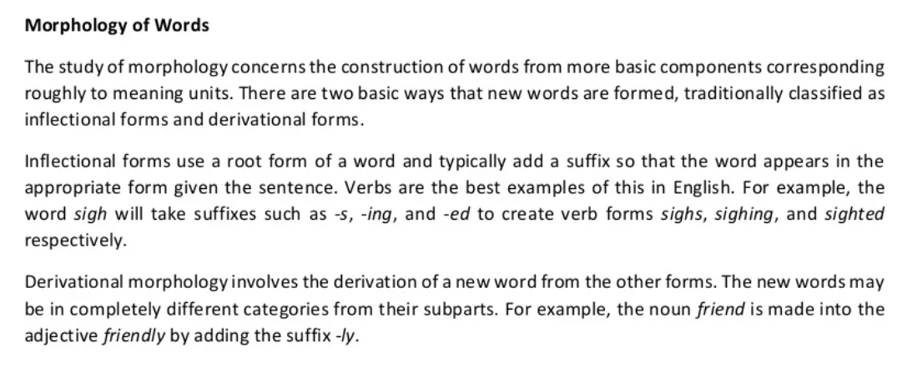

Slide 9
Morphemes
Smallest meaning bearing units constituting a word
Morphemes
Stem
Affixes
Prefixes
Suffixes
tree, go, fat
post - (postpone)
-ed (tossed)
Stem
Prefix
Suffix
reconsideration
re
consider
ation
Affixes in Hindi?

Slide 10
Inflection
Indicates some grammatical function like
Results in a word of the same class
Productivity
Case | लड़का (D) | लड़के (O)
Number | लड़का (Sg) | लड़के (Pl)
Person | जाऊँगा (1st) | जाओगे (2nd)
Gender | जाऊँगा(Masc) | जाऊँगी (Fem)
Tense | गया(Pas) | जाऊँगी (Fem)

Slide 11
Derivation
Usually, results in a word of a different class
-able when attached to a verb gives an adjective
read (V) + -able = readable (Adj)
Often meaning of the derived word is difficult to predict exactly
writer :: writer (one who writes)
paint :: painter (one who paints)
cut :: cutter? (an instrument used to cut)
Less productive
eatable :: readable :: runnable?

Slide 12
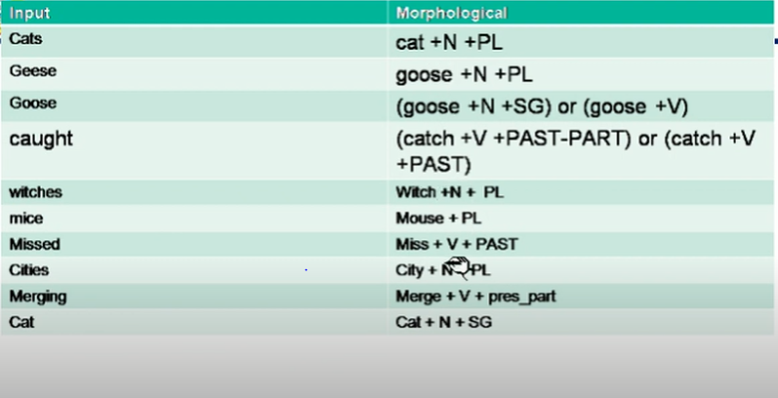

Slide 13
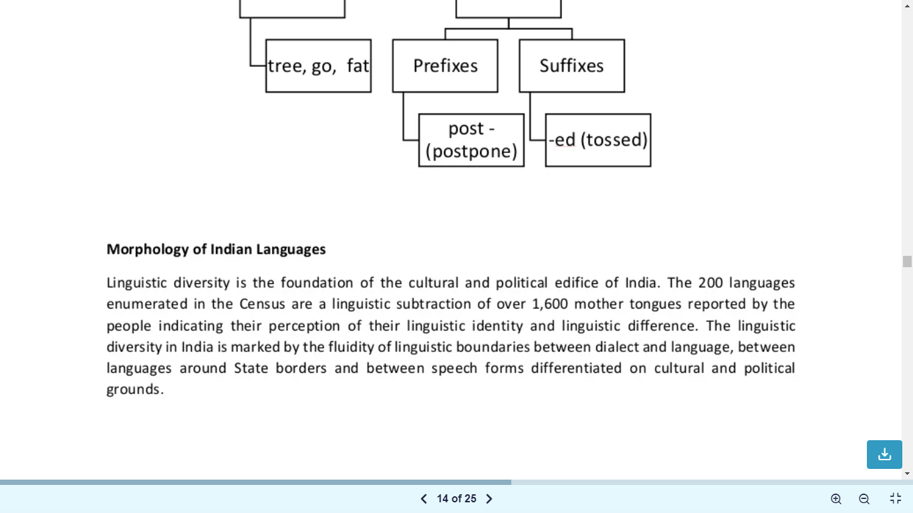

Slide 14
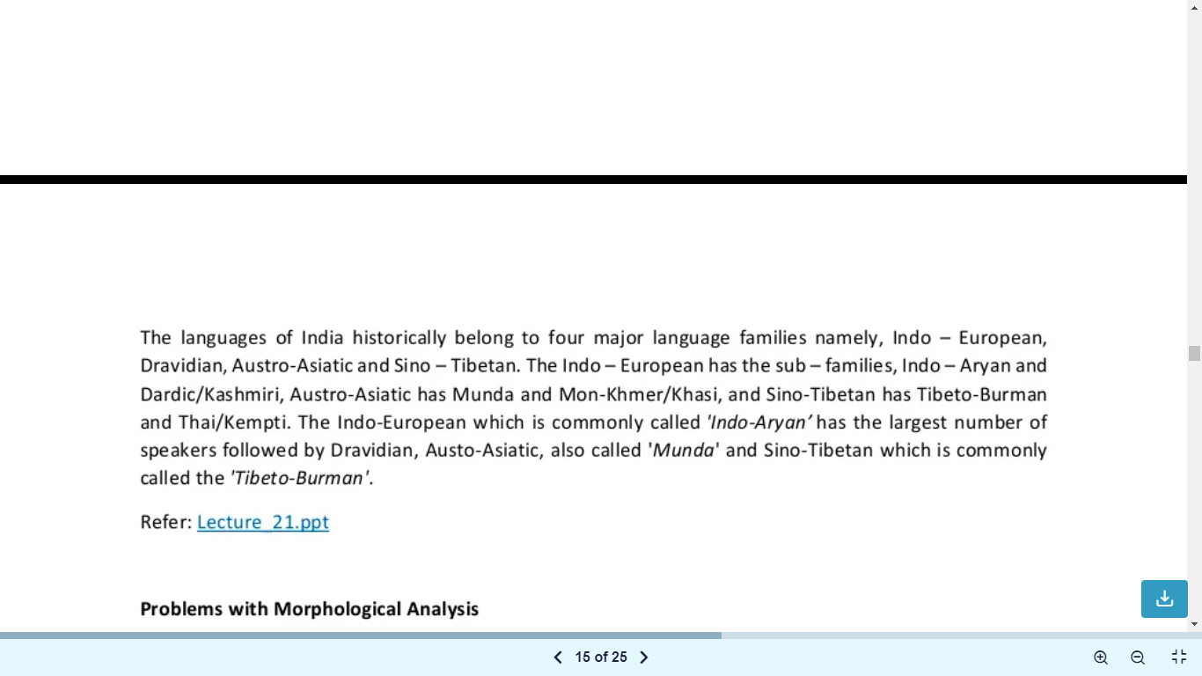

Slide 15
Problems in morphological analysis
Productivity
False Analysis
Bound based morphemes
“Linguistics, An Introduction to Language and Communication” by Adrian Akmajian, Richard A. Demers, Ann K. Farmer and Robert M. Harnish (5th Edition), pg 46 onwards

Slide 16
Productivity
Property of a morphological process to give rise to new formations on a systematic basis
Exceptions
Transitive Verb (read)
-able
Productive (readable)
Noun (game)
-able
Not Productive (gameable)
Peaceable | Actionable | Companionable
Saleable | Marriageable | Reasonable
Impressionable | Fashionable | knowledgeable

Slide 17
Productivity
The attachment of -able to transitive verbs is productive—that is, it happens quite freely—but its attachment to nouns is not productive.

Slide 18
MORPHOLOGICAL PRODUCTIVITY
Morphological productivity is the phenomenon that a morphological pattern (a systematic form-meaning correspondence) observed a set of complex words can be extended to new cases. This then leads to new complex words, or inflectional forms of words.
A morphological process is a means of changing a stem to adjust its meaning to fit its syntactic and communicational context.

Slide 19
FEATURES
Morphological productivity is the word formation process.
It is a phenomenon in which stem is changed semantically and syntactically to form new complex words.
Word formation process are compounding, blending, clipping, coinage, acronym, affixation, inflection and derivation etc
Morphological productivity has two concepts "availability" and "profitability". The former is systematic concept while the latter one is non systematic.

Slide 20
Self + ie= Selfie
Quick + ly= Quickly
Cold + er= Colder
Walk + er = Walker
Read + able = Readable
Good + ness =Goodness

Slide 21

False analysis
hospitable, sizeable
They don’t have the meaning “to be able”
They can not take the suffix -ity to form a noun
Analyzing them as the words containing suffix -able leads to false analysis

Slide 22
Bound Base Morphemes
Occur only in a particular complex word
Do not have independent existence
base (nonexistent)
morpheme (known)
Compound
malleable
feasible (fease+ible)
-able has the regular meaning “be able”
-ity form is possible
Base words don’t exit independently

Slide 23
More on Inflection
Noun inflectional suffixes | Plural marker -s Possessive marker ‘s
Verb inflectional suffixes | Third person present singular marker -s Past tense marker -ed Progressive marker -ing Past participle markers -en or –ed
Adjective inflectional suffixes | Comparative marker -er Superlative marker -est
Inflectional Suffixes in English

Slide 24
Spelling Rules
Generally words are pluralized by adding –s to the end
Words ending in –s, -z, -sh and sometimes –x require –es
buses, quizzes, dishes, boxes
Nouns ending in –y preceded by a consonant change the –y to -i
babies, floppies

Slide 25
Verbal Inflection
Morphological Form Classes | Regularly Inflected Verbs |  |  |  | Irregularly Inflected Verbs
Stem | Jump | Parse | Fry | Sob | Eat | Bring | Cut
-s form | Jumps | Parses | Fries | Sobs | Eats | Brings | Cuts
-ing participle | Jumping | Parsing | Frying | Sobbing | Eating | Bringing | Cutting
Past form | Jumped | Parsed | Fried | Sobbed | Ate | Brought | Cut
–ed participle | Jumped | Parsed | Fried | Sobbed | Eaten | Brought | Cut
Forms governed by spelling rules
Idiosyncratic forms

Slide 26
Morphological Parsing
Finding
Constituent morphemes
Features
Input | Morphological Parsed Output
cats | cat +N +PL
geese | goose +N +PL
goose | (goose +N +SG) or (goose +V)
gooses | goose +V +3G
caught | (catch +V +PAST-PART) or (catch +V +PAST)

Slide 27
Morphological parser
Lexicon | List of stems and suffixes along with basic information about them
Morphotactics | A model of morpheme ordering that explains which classes of morphemes can follow other classes of morphemes
Orthographic Rules | Spelling rules used to model the changes that occur in the work usually when two morphemes combine

Slide 28
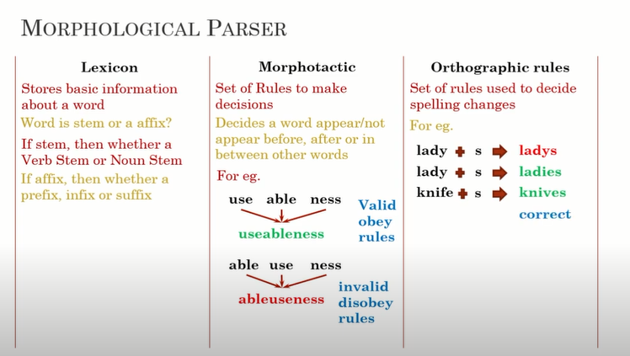
https://www.youtube.com/watch?v=RIfmj7BSVxE&t=162s
https://www.youtube.com/watch?v=U5oHxrDVfMU

Slide 29
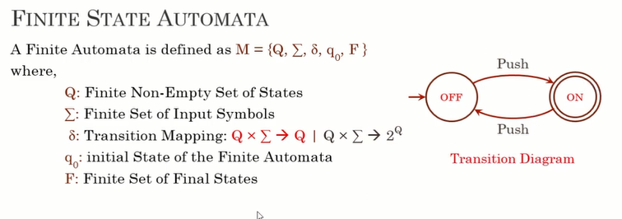

Slide 30
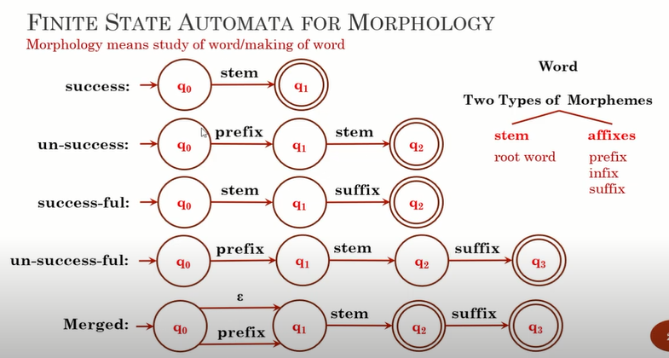

Slide 31
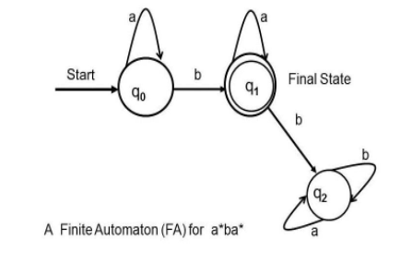
FSA
draw a single finite state automata for the following string: a*ba*

Slide 32
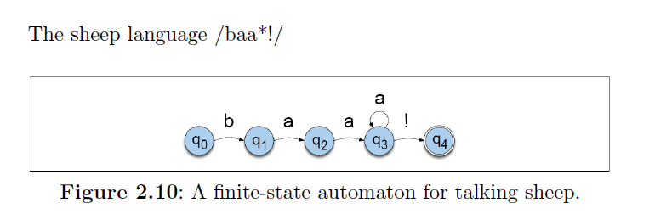
FSA for talking sheep/sheep language/baa+!

Slide 33
Morphological Recognition
reg-noun | irregular-sg-noun | irregular-pl-noun | plural
flower | goose | geese | -s
cat | sheep | sheep
dog | mouse | mice
Lexicon

Slide 34
Morphological Recognition: Nouns
reg-noun | irregular-sg-noun | irregular-pl-noun | plural
flower | goose | geese | -s
cat | sheep | sheep
dog | mouse | mice
Lexicon
reg-noun
plural (-s)
q0
q1
q2
FSA
Note: Here, we are ignoring the nouns which take the suffix –es for pluralization
irreg-pl-noun
irreg-sg-noun

Slide 35
Adjectives
Type | Properties | Examples
adj-root1 | Occur with un- and -ly | happy, real
Adj-root2 | Can’t occur with un- and -ly | big, red

Slide 36
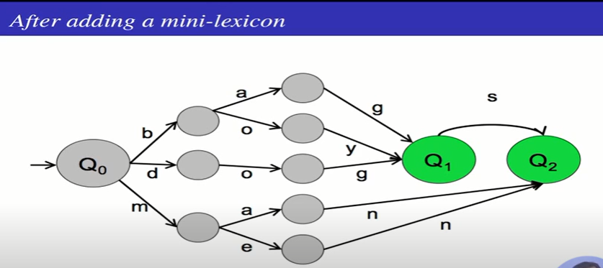

Slide 37
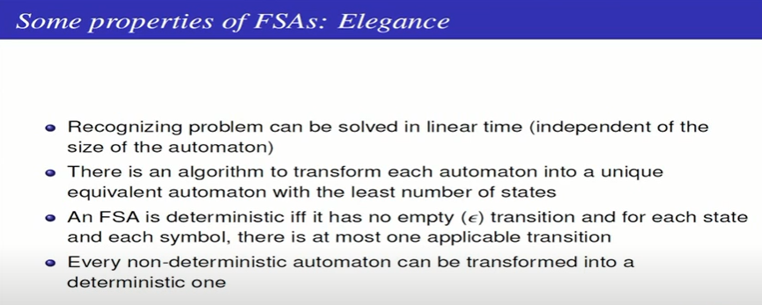

Slide 38
Adjectives
Type | Properties | Examples
adj-root1 | Occur with un- and -ly | happy, real
Adj-root2 | Can’t occur with un- and -ly | big, red
adj-root1
-er
-ly
-est
q1
q2
un-
q0
q5
adj-root1
ε
q3
q4
-er
-est
adj-root2

Slide 39
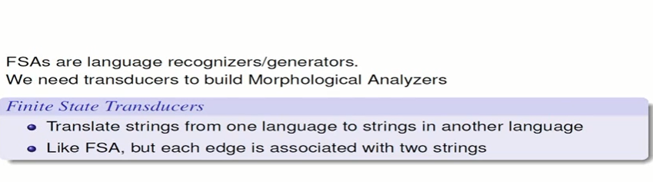

Slide 40
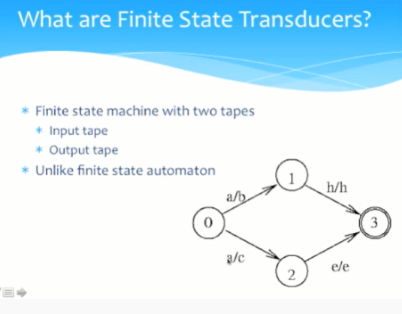

Slide 41
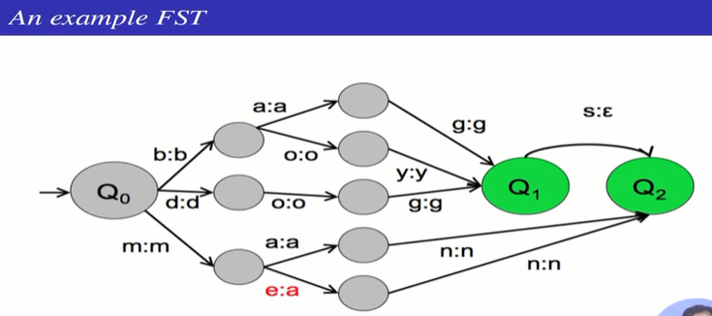

Slide 42
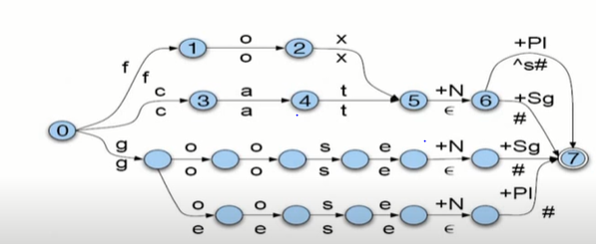
https://www.youtube.com/watch?v=DDIRpKIP7nI

Slide 43
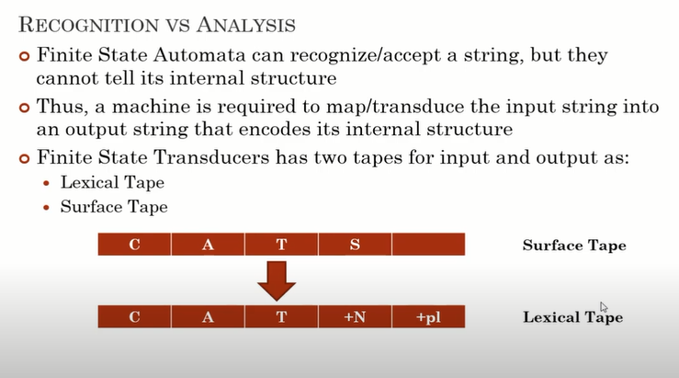

Slide 44
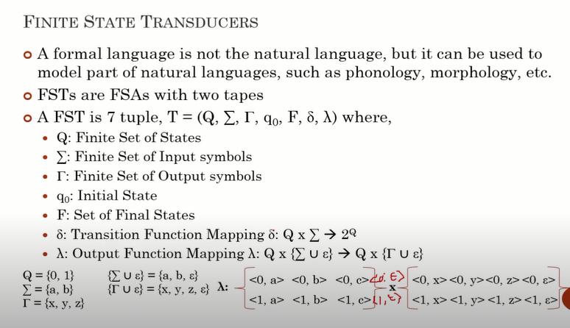

Slide 45
Automatic morphology learning 1
•
Problem
Paradigm stem + affixea
Obtaining the stems
Classification of stems into models
Learning part of the morphology (e.g. derivational)
Two approaches
No previous morphologic knowledge is available
Goldsmith, 2001
Brent, 1999
Snover, Brent, 2001, 2002
Morphologic knowledge can be used
Oliver at al, 2002
•

Slide 46
Automatic morphology learning 2
•
Automatic morphological analysis
Identification of borders betwen morphemes
Zellig Harris
{prefix, suffix} conditional entropy
bigrams and trigrams with high probability of forming a morpheme
Learning of patterns or rules of mapping between pairs of words
Global approach (top-down)
Golsdmith, Brent, de Marcken

Slide 47
Automatic morphology learning 3
•
Goldsmith’s system based on MDL (Minimum Description Length)
Initial Partition: word -> stem + suffix
split-all-words
A good candidate to {stem, suffix} splitting in a word has to be a good candidate in many other words
MI (mutual information) strategy
•
Faster convergence
Learning Signatures
{signatures, stem, suffixes}
MDL

Slide 48
Automatic morphology learning 4
•
Semi-automatic morphological analysis
Oliver, 2004
Starts with a set of manually written morphological rules
TL:TF:Desc
•
lemma ending form ending POS
•
•
Lists of non flexive classes , closed classes and irregular words
Corpora
Serbo-Croatian 9 Mw
Russian 16 Mw

Slide 49
Parsing
The word ‘Parsing’ whose origin is from Latin word ‘pars’ (which means ‘part’), is used to draw exact meaning or dictionary meaning from the text.
It is also called Syntactic analysis or syntax analysis. Comparing the rules of formal grammar, syntax analysis checks the text for meaningfulness.

Slide 50
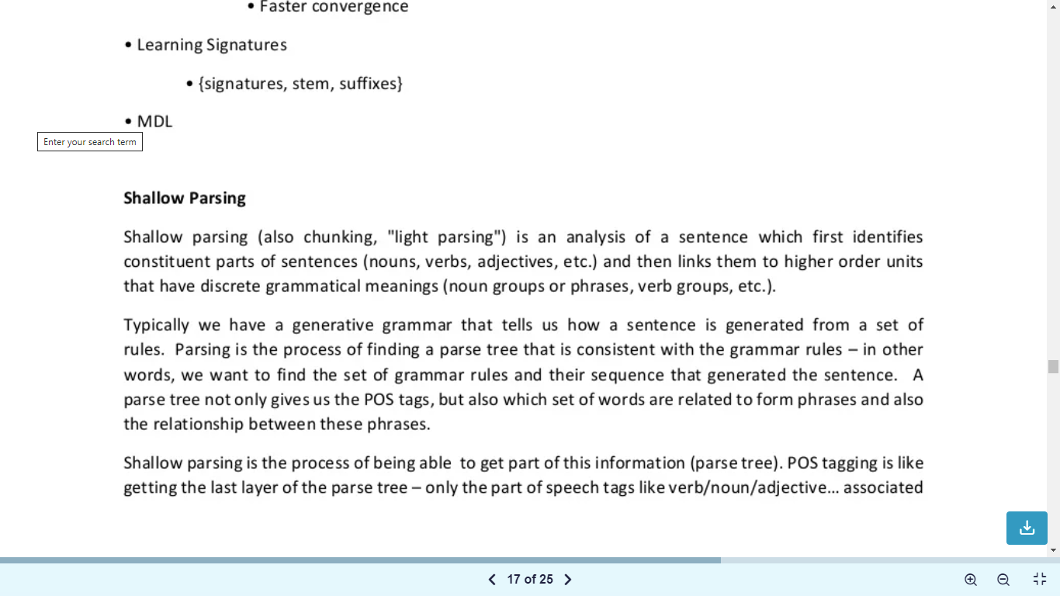
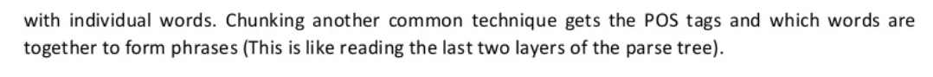

Slide 51
POS tagging would give a POS tag to each and every word in the input sentence.
Parsing the sentence (using the stanford pcfg for example) would convert the sentence into a tree whose leaves will hold POS tags (which correspond to words in the sentence), but the rest of the tree would tell you how exactly these these words are joining together to make the overall sentence. For example an adjective and a noun might combine to be a 'Noun Phrase', which might combine with another adjective to form another Noun Phrase (e.g. quick brown fox) (the exact way the pieces combine depends on the parser in question).
Parsing simulator http://nlp.stanford.edu:8080/parser/index.jsp

Slide 52
A shallow parser or 'chunker' comes somewhere in between these two. A plain POS tagger is really fast but does not give you enough information and a full blown parser is slow and gives you too much. A POS tagger can be thought of as a parser which only returns the bottom-most tier of the parse tree to you. A chunker might be thought of as a parser that returns some other tier of the parse tree to you instead. Sometimes you just need to know that a bunch of words together form a Noun Phrase but don't care about the sub-structure of the tree within those words (i.e. which words are adjectives, determiners, nouns, etc and how do they combine). In such cases you can use a chunker to get exactly the information you need instead of wasting time generating the full parse tree for the sentence.

Slide 53
Phrasal Structures
A phrase can be a single word or a combination of words based on the syntax and position of the phrase in a clause or sentence. For example, in the following sentenceMy dog likes his food.there are three phrases. "My dog" is a noun phrase, "likes" is a verb phrase, and "his food" is also a noun phrase.
There are five major categories of phrases:
Noun phrase (NP): These are phrases where a noun acts as the head word. Noun phrases act as a subject or object to a verb or an adjective. In some cases a noun phrase can be replaced by a pronoun without changing the syntax of the sentence. Some examples of Noun phrases are "little boy", "hard rock", etc.

Slide 54
2. Verb phrase (VP): These phrases are lexical units that have a verb acting as the head word. Usually there are two forms of verb phrases. One form has the verb components as well as other entities such as nouns, adjectives, or adverbs as parts of the object. The verb here is known as a finite verb. For example in the sentence “The boy is playing football”, "playing football" is the finite verb phrase. The second form of this includes verb phrases which consist strictly of verb components only. For example, "is playing" in the same sentence is such a verb phrase.

Slide 55
3. Adjective phrase (ADJP): These are phrases with an adjective as the head word. Their main role is to describe or qualify nouns and pronouns in a sentence, and they will be either placed before or after the noun or pronoun. The sentence, "The cat is too cute" has an adjective phrase, "too cute", qualifying "cat".

Slide 56
4. Adverb phrase (ADVP): These are phrases where adverb acts as the head word in the phrase. Adverb phrases are used as modifiers for nouns, verbs, or adverbs themselves by providing further details that describe or qualify them. In the sentence "The train should be at the station pretty soon", the adverb phrase "pretty soon" describes when the train would be arriving.

Slide 57
5. Prepositional phrase (PP): These phrases usually contain a preposition as the head word and other lexical components like nouns, pronouns, and so on. It acts like an adjective or adverb describing other words or phrases. The phrase "going up the stairs" contains a prepositional phrase "up", describing the direction of the stairs.
These five major syntactic categories of phrases can be generated from words using several rules, utilizing syntax and grammars of different types.

Slide 58
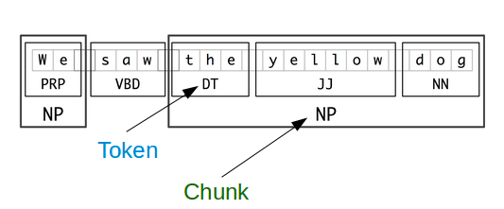
Chunking Example

Slide 59
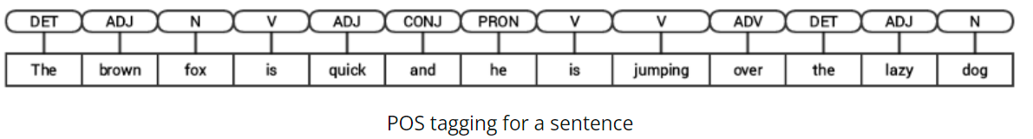
The brown fox is quick and he is jumping over the lazy dog”

Slide 60
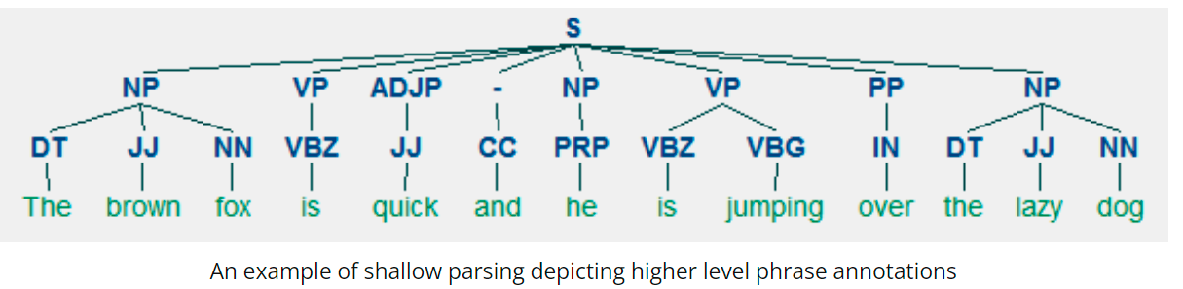

Slide 61
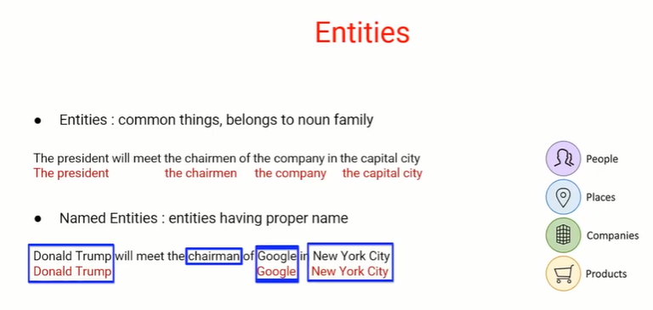

Slide 62
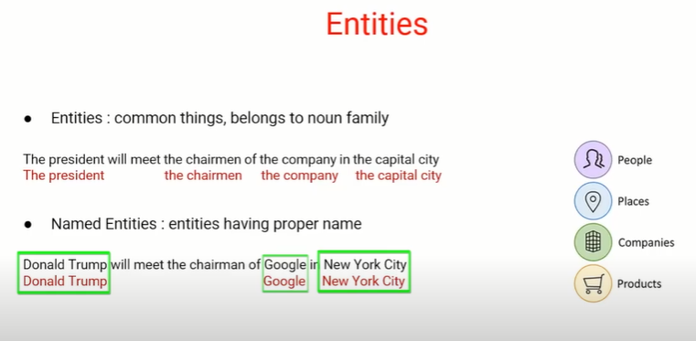

Slide 63
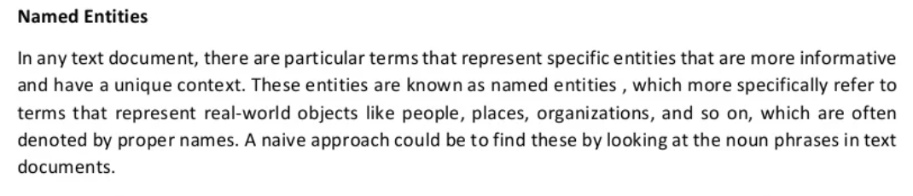

Slide 64
Examples of named entities include Barack Obama, New York City, Volkswagen Golf, or anything else that can be named. Named entities can simply be viewed as entity instances (e.g., New York City is an instance of a city).

Slide 65
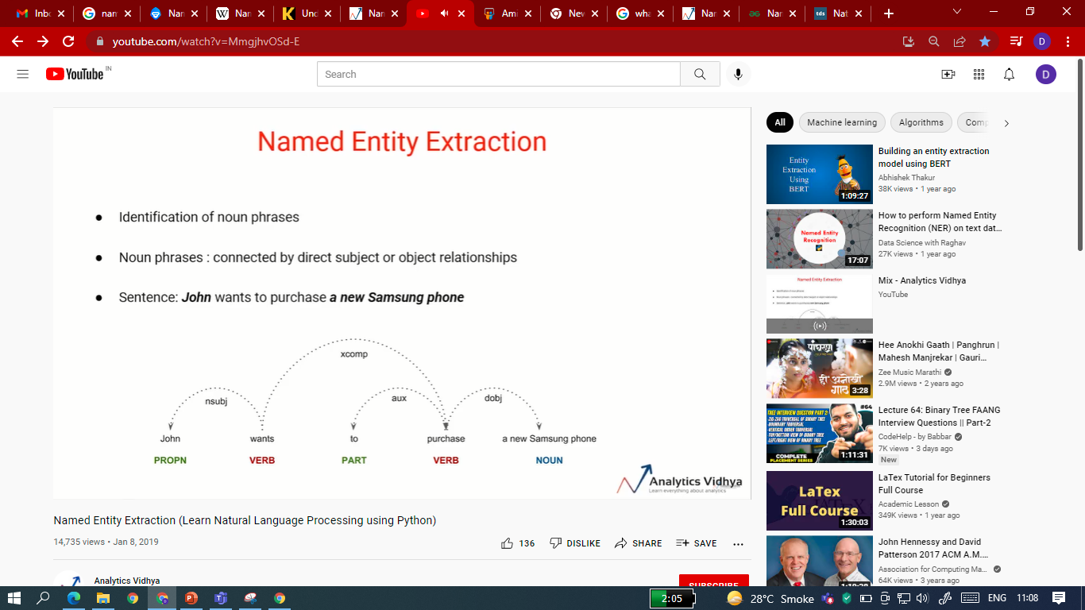
Notes:
Dependency Parsing is the process to analyze the grammatical structure in a sentence and find out related words as well as the type of the relationship between them. Each relationship:
Has one head and a dependent that modifies the head.
Is labeled according to the nature of the dependency between the head and the dependent. These labels can be found at Universal Dependency Relations.

Slide 66
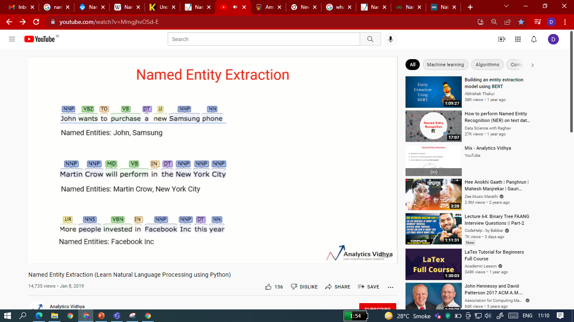

Slide 67
Named Entity Recognition is one of the key entity detection methods in NLP.
Named entity recognition is a natural language processing technique that can automatically scan entire articles and pull out some fundamental entities in a text and classify them into predefined categories. Entities may be,
Organizations,
Quantities,
Monetary values,
Percentages, and more.
People’s names
Company names
Geographic locations (Both physical and political)
Product names
Dates and times
Amounts of money
Names of events

Slide 68
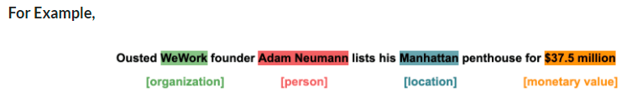
In simple words, Named Entity Recognition is the process of detecting the named entities such as person names, location names, company names, etc from the text.
It is also known as entity identification or entity extraction or entity chunking.
With the help of named entity recognition, we can extract key information to understand the text, or merely use it to extract important information to store in a database.

Slide 69
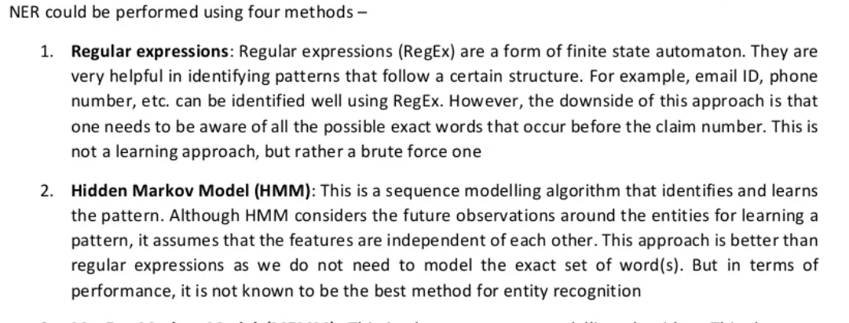

Slide 70
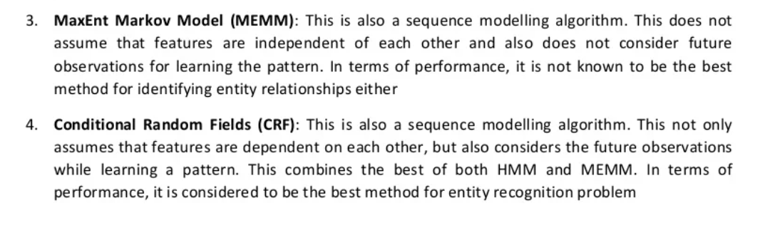

Slide 71
Speech recognition enable the recognition and translation of spoken language into text by computers with the main benefit of searchability.
It is also known as automatic speech recognition (ASR), computer speech recognition or speech to text (STT).
It incorporates knowledge and research in the computer science, linguistics and computer engineering fields.
The reverse process is speech synthesis.

Slide 72
What is speech recognition?
Speech recognition, or speech-to-text, is the ability of a machine or program to identify words spoken aloud and convert them into readable text.
Rudimentary speech recognition software has a limited vocabulary and may only identify words and phrases when spoken clearly.
More sophisticated software can handle natural speech, different accents and various languages.

Slide 73
Speech recognition is used to identify words in spoken language.
Voice recognition is a biometric technology for identifying an individual's voice.

Slide 74
Speech recognition systems use computer algorithms to process and interpret spoken words and convert them into text. A software program turns the sound a microphone records into written language that computers and humans can understand, following these four steps:
analyze the audio;
break it into parts;
digitize it into a computer-readable format; and
use an algorithm to match it to the most suitable text representation.

Slide 75
Speech recognition software must adapt to the highly variable and context-specific nature of human speech. The software algorithms that process and organize audio into text are trained on different speech patterns, speaking styles, languages, dialects, accents and phrasings. The software also separates spoken audio from background noise that often accompanies the signal.

Slide 76
To meet these requirements, speech recognition systems use two types of models:
Acoustic models. These represent the relationship between linguistic units of speech and audio signals.
Language models. Here, sounds are matched with word sequences to distinguish between words that sound similar.

Slide 77
What is word boundaries and examples?
A word boundary is the part or area of a sentence where one word ends and another one begins. The white spaces between words let us know where one word ends and another one begins. Example: John-is-tall.

